Slide 1
RAGNAROK
Board relation

Slide 2
Main tasks
Development
1
Heutistic
2
Optimization
3
Algorithm and structure
Different function and genetic algorithm
Result and optimization

Slide 3
1. Development

Slide 4
Algorithm
We found different approaches for development of this game, but we've tested just search algorithms:
Minimax
Alpha-beta pruning
Negamax

Slide 5
Structure code
Simple view about our structure of code:
Class Game
Class AlphaBeta
Class TT
Class Game: contains rules of game
Class AlphaBeta: contains algorithm search
Class TT: contains transposition table

Slide 6
2. Heuristic

Slide 7
Heuristic
Main rule
Second rule
Third rule
After the first step of implementation, we try to improve our algorithm with this simple heuristics:
Main rule: give the value to the move. The function use the weights that come from genetic algorithm.
Second rule: Two functions for calculate the max value in game for the black and the white player.
Third rule: Two functions for calculate the free sides and the free escapes.

Slide 8
Genetic Algorithm
We have developed the genetic algorithm for search the optimal weight of our function. The characteristics:
Population:
Fitness function:
Selection:
Genetic operators:

Slide 9
3. Optimization

Slide 10
Optimization
First Step
Second Step
Third Step
We've improved our code with these simple step:
1.
2.
3.
AAAA
AAAA
AAAA

Slide 11
Conclusion
Final Comment:

Slide 12
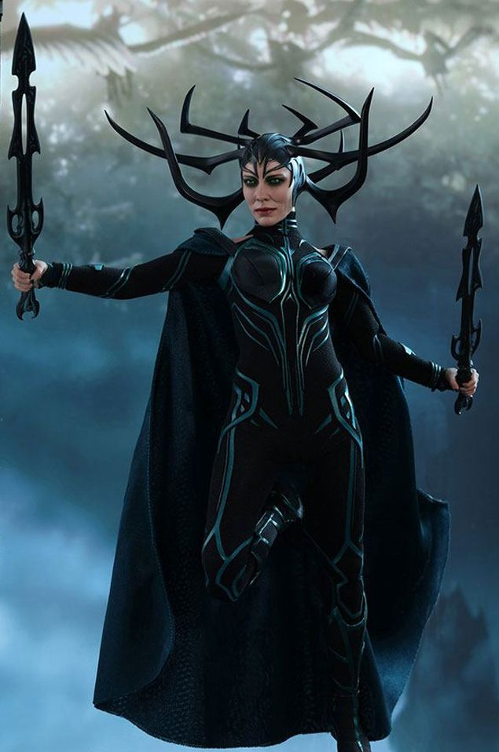
Thank You

